Slide 1
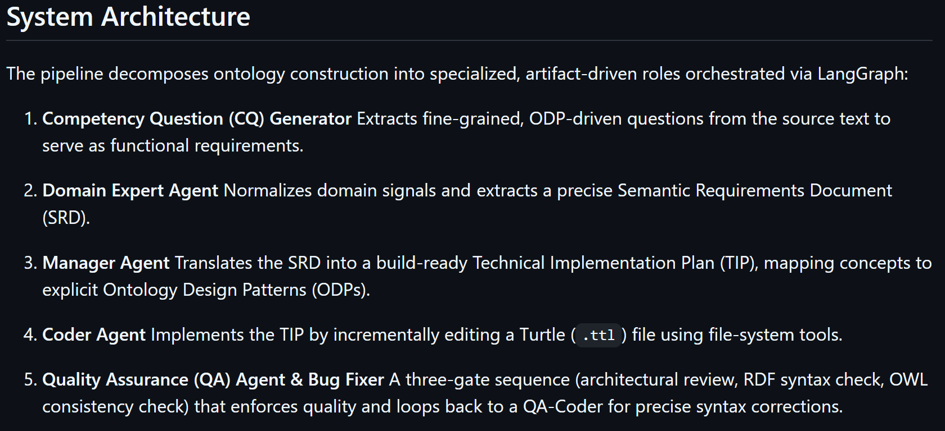
Based on:
https://github.com/brains-group/towards_automated_ontology_generation

Slide 2
What had to be added
Where the implementations differ
Reference to structure the ontology based on Farzad’s implementation (dart-project-main in Documents)
Code

Slide 3
Accuracy & metrics
How accurate it is?
How specific?
Any facts omitted, what is included?

Slide 4
Screenshot of the system

Slide 5
Bar chart the same as made in the pdf

